Slide 1
ENVIRONMENTAL PERFORMANCE 2022
| 02.02.2023
PMG POLMETASA

Slide 2
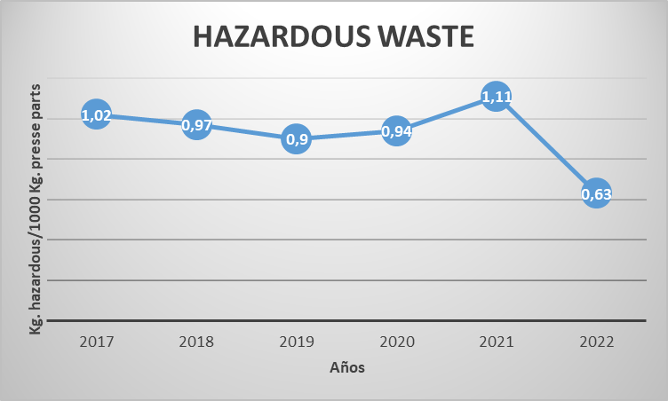
ENVIRONMENTAL PERFORMANCE
ISO 14001:2015
HAZARDOUS WASTE

Slide 3
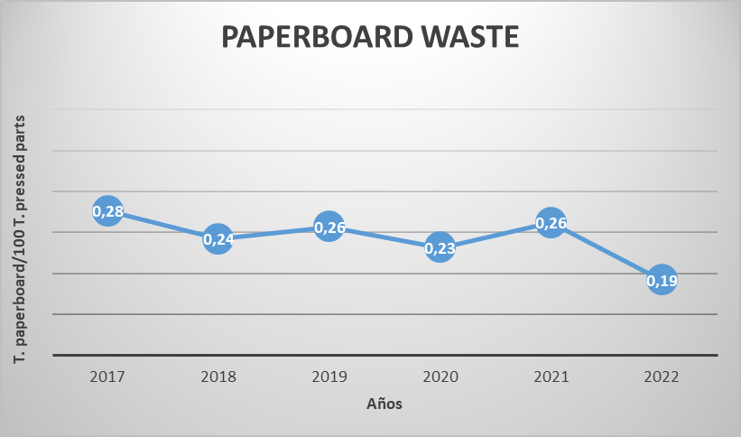
ENVIRONMENTAL PERFORMANCE
ISO 14001:2015
NON HAZARDOUS WASTE

Slide 4
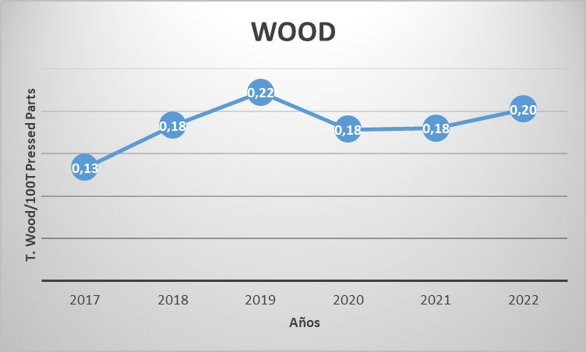
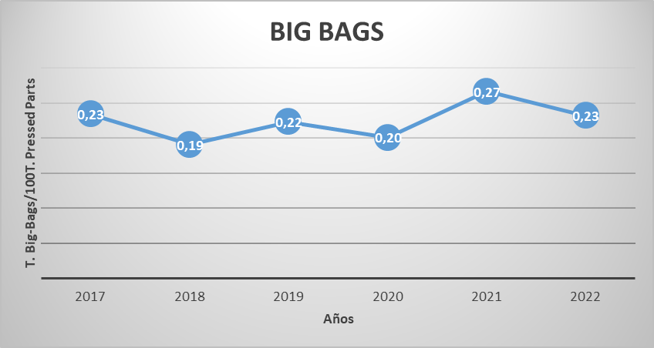
ENVIRONMENTAL PERFORMANCE
ISO 14001:2015
NON HAZARDOUS WASTE

Slide 5
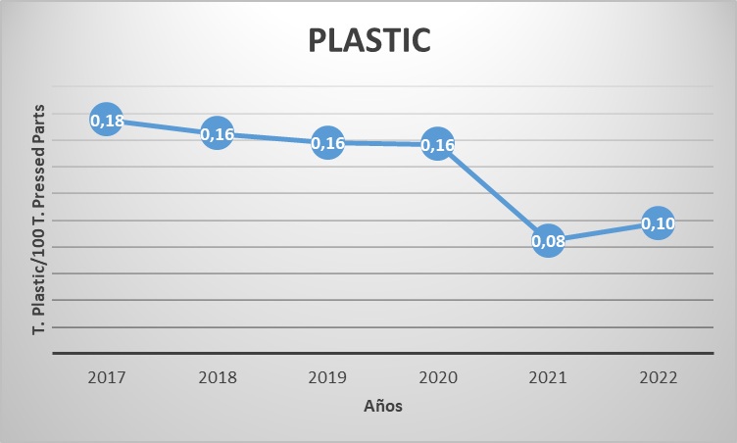
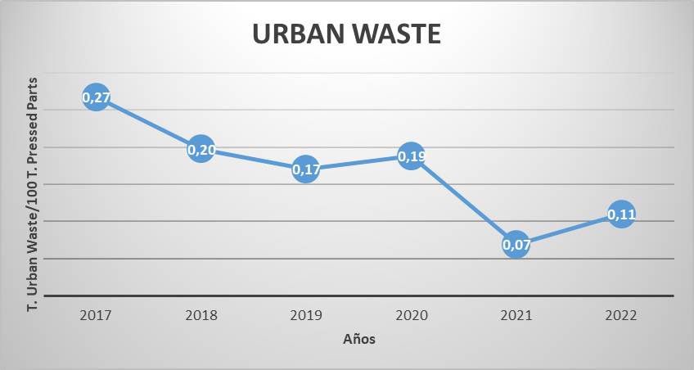
ENVIRONMENTAL PERFORMANCE
ISO 14001:2015
NON HAZARDOUS WASTE

Slide 6
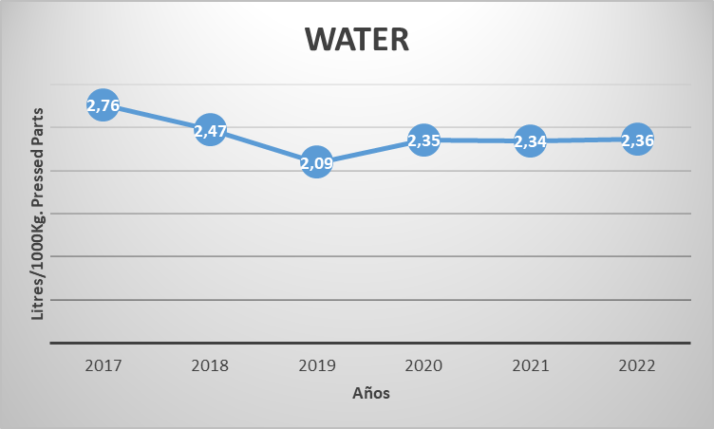
ENVIRONMENTAL PERFORMANCE
ISO 14001:2015
WATER CONSUMPTION

Slide 7
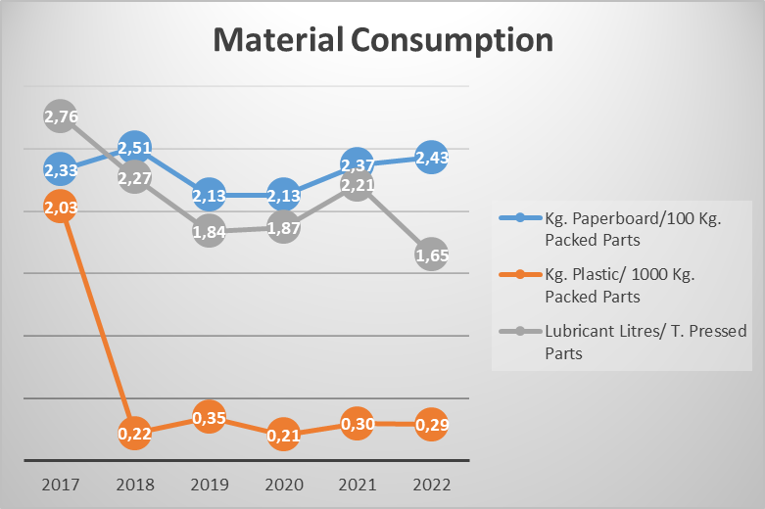
ENVIRONMENTAL PERFORMANCE
ISO 14001:2015
MATERIAL CONSUMPTION

Slide 8
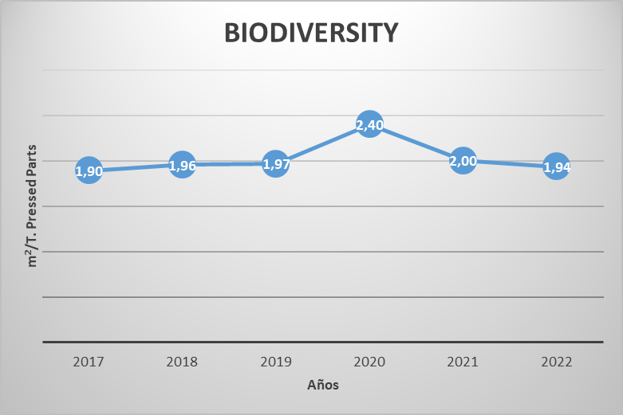
ENVIRONMENTAL PERFORMANCE
ISO 14001:2015
BIODIVERSITY

